Slide 1

Meeting 1
Introduction to SOPHEE
IEEE - CSULB Branch
Notes:
C - Introduce SOPHEE and mentors

Slide 2
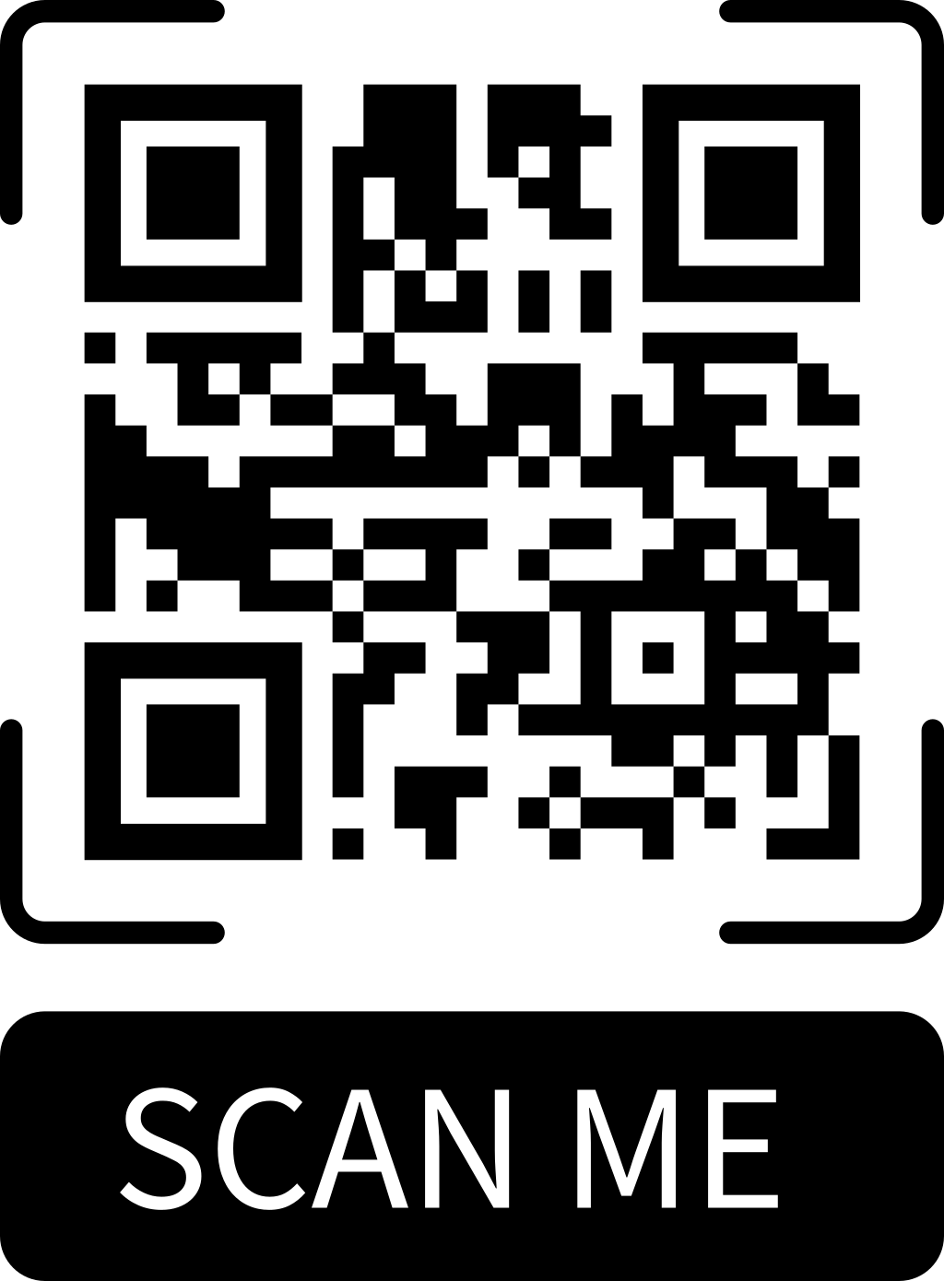
Before we get started, please fill out the attendance form below

Slide 3

Agenda
Intro & Background
What does SOPHEE offer?
Why does it matter?
Meeting Information
What to Expect?
Final Project: Temperature Sensor Circuit
Demo: Installing Software
Notes:
R
Intro: Stands for SOPHMORES IN EE.
What: offers a learning space to introduce or reintroduce intermediate fundamentals of electrical circuits. This semedster

Slide 4
What is SOPHEE?
Sophomores in Electrical Engineering
Want to apply the skills you learn in class? Thought about wanting to build a project more complex and usable in the real world? Need something to put on your resume?
Notes:
C

Slide 5
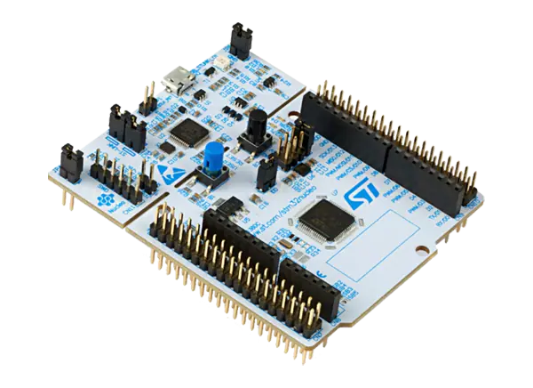
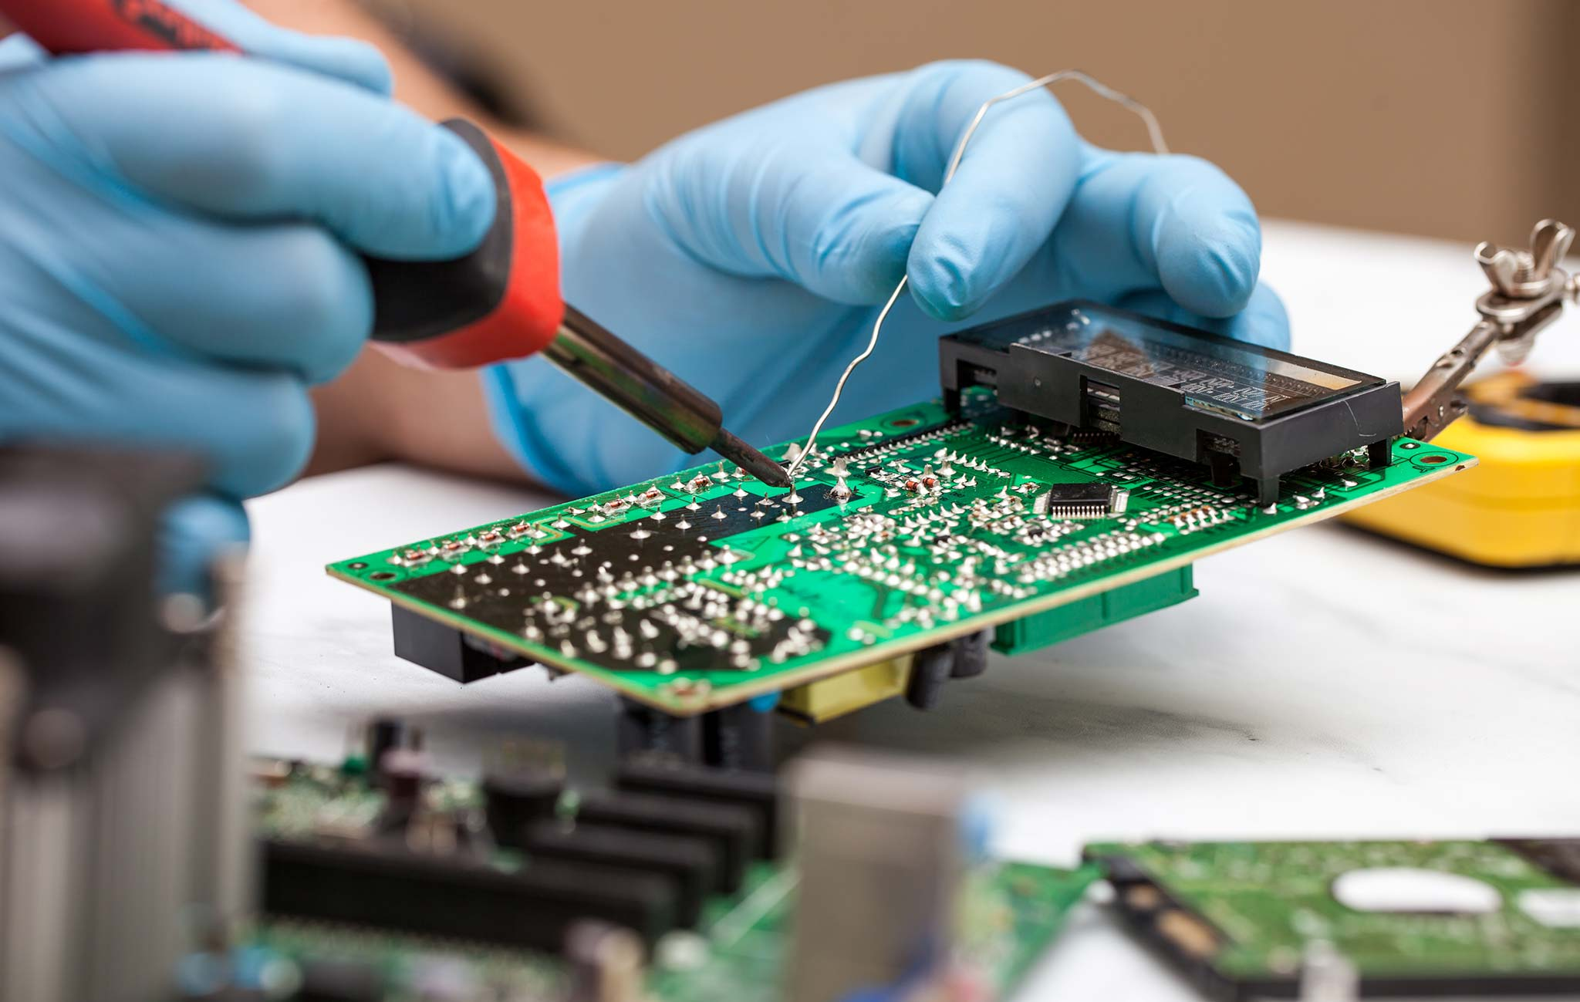
What skills can you learn?
How to solder, use breadboards, code with and use STM32 microcontrollers, etc.
Notes:
R
Soldering- welding an electronic component to another component or a board
Breadboarding- prototyping a circuit design by putting components on a testing plane such as breadboard (practical blueprint

Slide 6
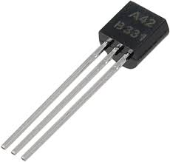
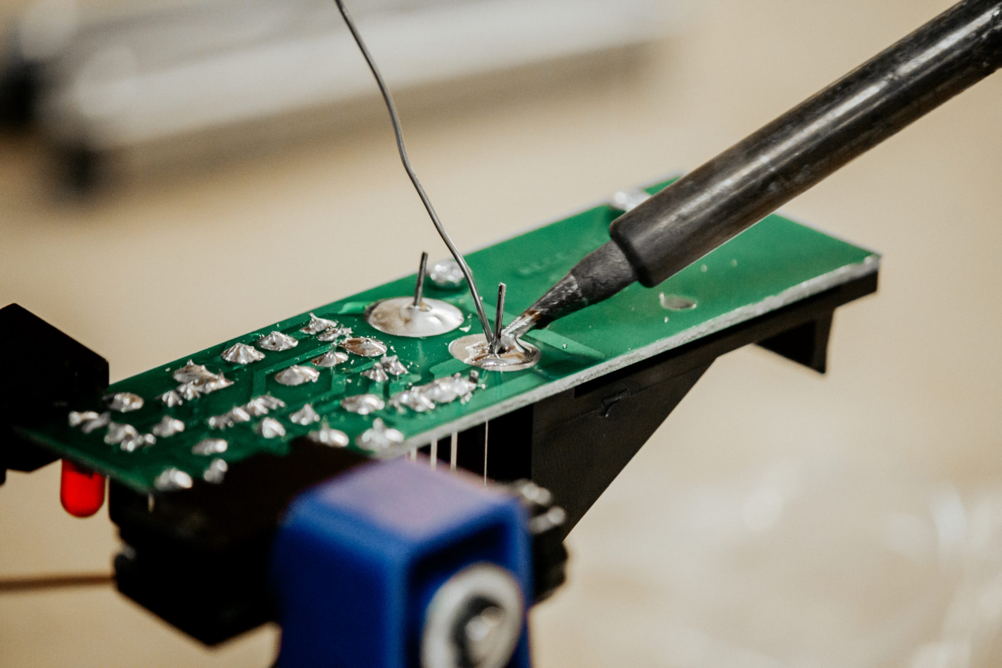
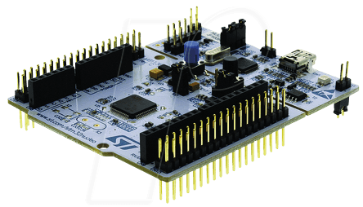
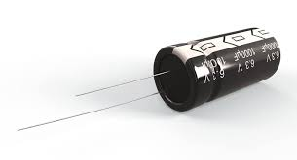
What equipment will you be using?
Soldering irons, STM32 dev boards, sensor boards, and much more!
Notes:
C

Slide 7
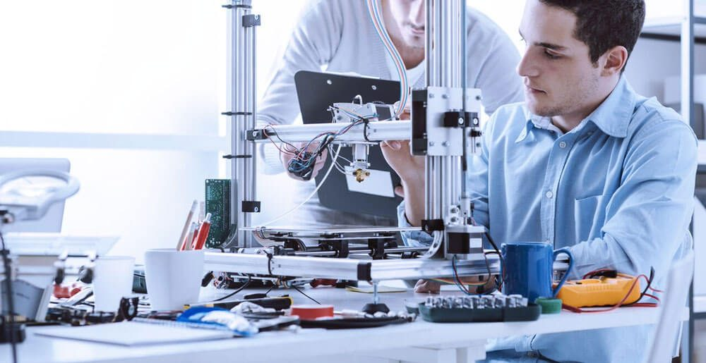

So why does it matter?
The SOPHEE program not only teaches you necessary and useful skills, it helps to put something on your resume!
nice on your resume!
Notes:
R
Skills learned in sophee will transfer over to many engineering applications. For those interested in OPS, the SOPHEE skills touch on design, controls, problem solving, and many useful necessities for starting your project

Slide 8
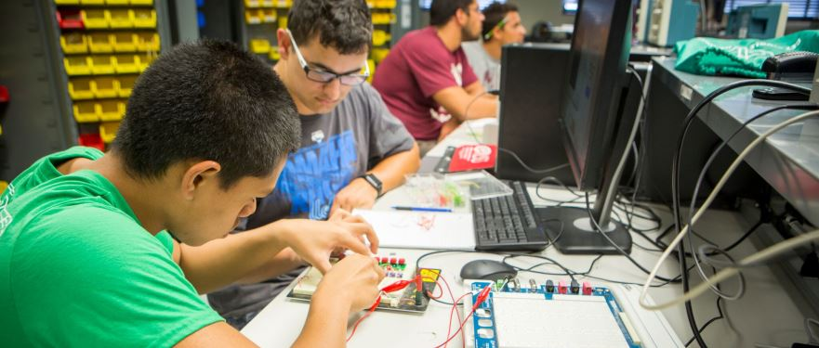
So why does it matter? (cont’d)
Engineers need to be able to critically analyze the situation and apply themselves to create a solution, while being able to problem solve, troubleshoot, and be aware of how to actually work on what they are calculating and studying.
Notes:
C

Slide 9

How can you sign up?
There are no requirements needed to sign up. All you have to do is visit and participate in one of our two weekly meetings!
Notes:
R

Slide 10
Demo: Installing Software
Install Altium Designer with Student License for PCB design (free)
Altium Student Lab - Free Licensing, Tools, and Resources for Students
Install STM32CubeIDE to write code for the STM32 (free)
STM32CubeIDE - Integrated Development Environment for STM32 – STMicroelectronics
Install a terminal emulator like PuTTY (to receive information from microcontroller)
Download PuTTY - a free SSH and telnet client for Windows
Notes:
C

Slide 11
Meeting Information
This is an 8-week program with two identical 1-hour meetings a week.
Meeting Times:
Monday/Tuesday 1:30PM - 2:30PM
Every meeting will have a teaching portion followed by a demo/lab portion to get some hands-on experience!
Notes:
C

Slide 12

Who can participate?
Anyone can! Although, it is recommended you have an understanding of basic electronic devices, equations, and coding seen in FREE program
Ohm’s Law : V=IR
Kirchhoff's Voltage Law
Kirchhoff's Current Law
Basic C skills
Notes:
R
This course will be building off of FREE program

Slide 13

What to expect?
Building Up to a Temperature Sensor Project!
Embedded Systems and Applications
STM32 Specifications and Peripherals
Capacitors, Analog Filters
Transistors Uses
HAL Programming
Communication Protocols
Schematic and PCB Creation, Datasheeting
Building the Final Project
Notes:
C

Slide 14
Skills
Major Classes
EE 346 (ET 386)
EE 330 (ET 260 / 341)
EE 211 (ET 250 / 252)
EE 186 (ET 286)
Coding
C, HAL Libraries
Skills
Soldering
Breadboarding
PCB Design
Digital Multimeter/Oscilloscope
Notes:
R

Slide 15
What you can start doing
New to C programming?
Highly recommend finding a short intro to C on youtube to watch
Control Structures for C Programming (variables, control structures)
New to electronics?
How to breadboard (Breadboard layout)
Learn basic electronic components names and uses
https://www.instructables.com/Basic-Electronics
https://www.youtube.com/watch?v=6WReFkfrUIk&ab_channel=ScienceBuddies
How do I stay updated?
Please join the SOPHEE role on the IEEE discord by going to #SELF_ROLES
This will allow you to stay updated and prepared for projects
Discord Link
Notes:
C

Slide 16
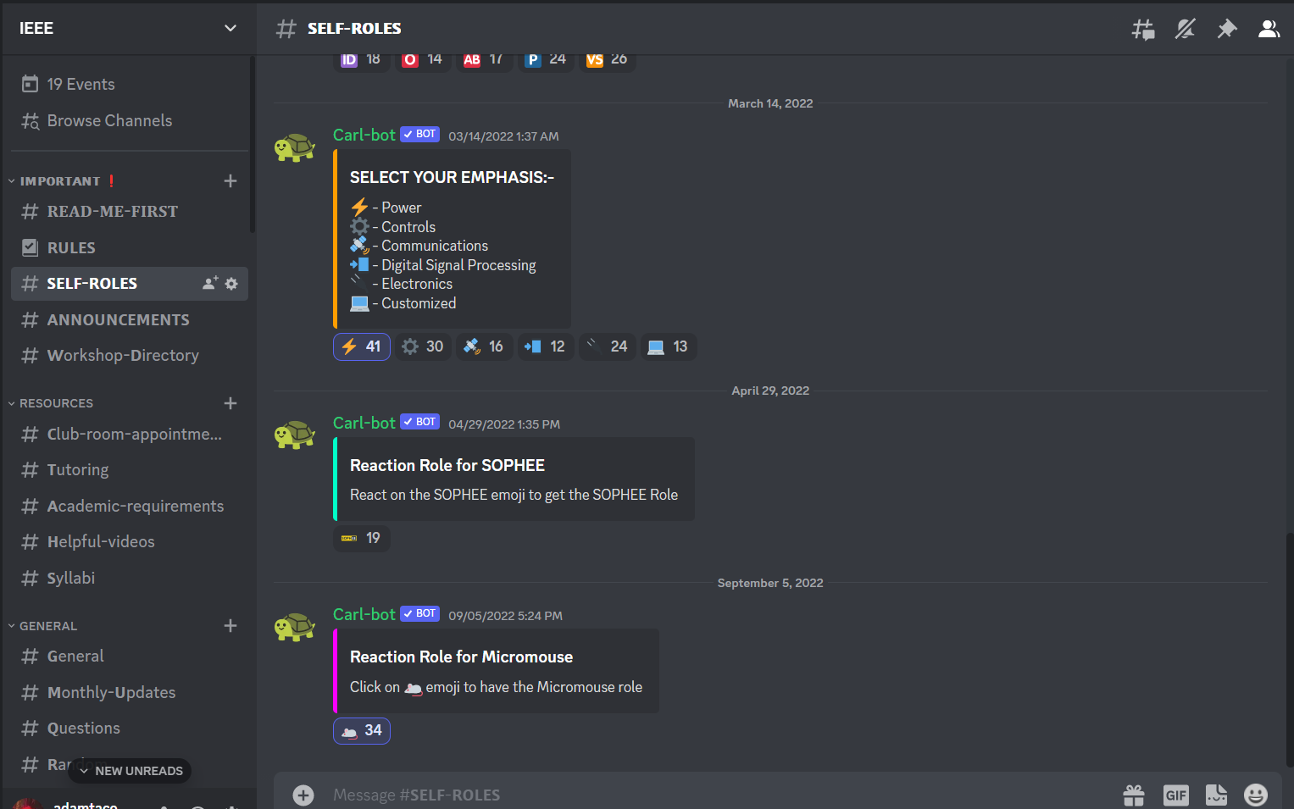
Notes:
R

Slide 17
Join us next meeting to learn about embedded systems! Please have STM32Cube IDE and PuTTY installed.
Any Questions?
Notes:
R
On Spare time: Q/A session
Mentors ask questions to the audience: What are you interested in seeing?

